Slide 1
PERSONALITY ADJECTIVES
What are you like?
What´s your brother like?
WHAT + + + LIKE ?
I´m sociable and funny
He´s bossy and selfish
AM
IS
ARE

Slide 2
FUNNY

Slide 3
TALENTED

Slide 4
STRONG

Slide 5
KIND

Slide 6
SHY

Slide 7
NERVOUS

Slide 8
SELFISH

Slide 9
EASY GOING

Slide 10
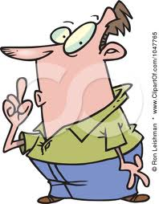
QUIET

Slide 11
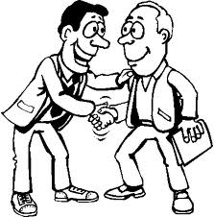
FRIENDLY,

Slide 12
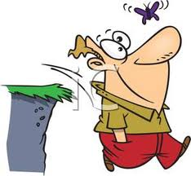
EASYGOING

Slide 13
TALKATIVE

Slide 14
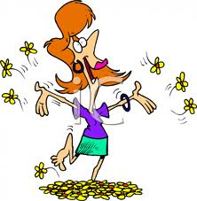
CHEERFUL

Slide 15
KIND

Slide 16
GENEROUS

Slide 17
SELFISH

Slide 18
POLITE

Slide 19
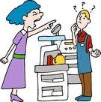
RUDE

Slide 20
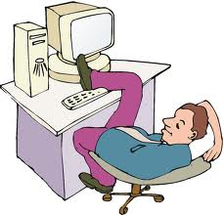
LAZY

Slide 21
,HARDWORKING

Slide 22
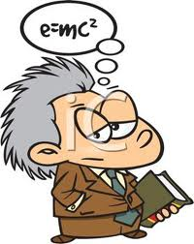
CLEVER

Slide 23
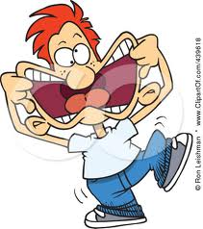
FUNNY

