Slide 1
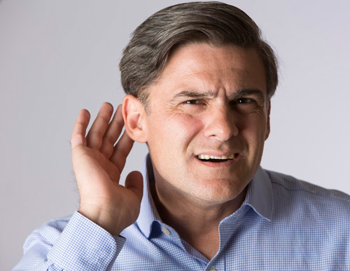
TEKRAR SÖYLE! A. GOOD MORNING! B. LET’S GO! C. SAY IT AGAIN!

Slide 2
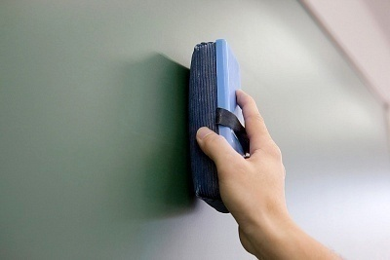
TAHTAYI SİL! A. CLEAN THE TABLE! B. CLEAN THE BOARD! C. MAY I COME IN?

Slide 3
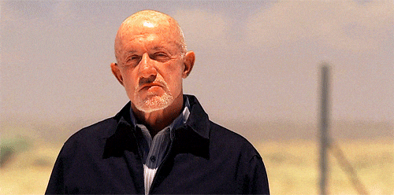
BİR FİKRE KATILMIYORSAK NE DERİZ? A. I THINK SO B. I DON’T THINK SO C. YES, I AM

Slide 4
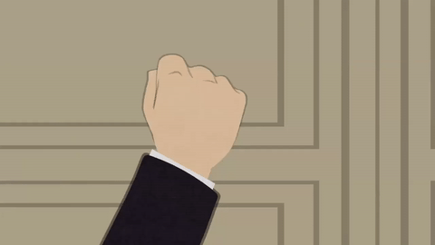
İÇERİ GİREBİLİR MİYİM? A. MAY I TURN ON THE LIGHT? B. MAY I COME IN? C. MAY I GO OUT?

Slide 5
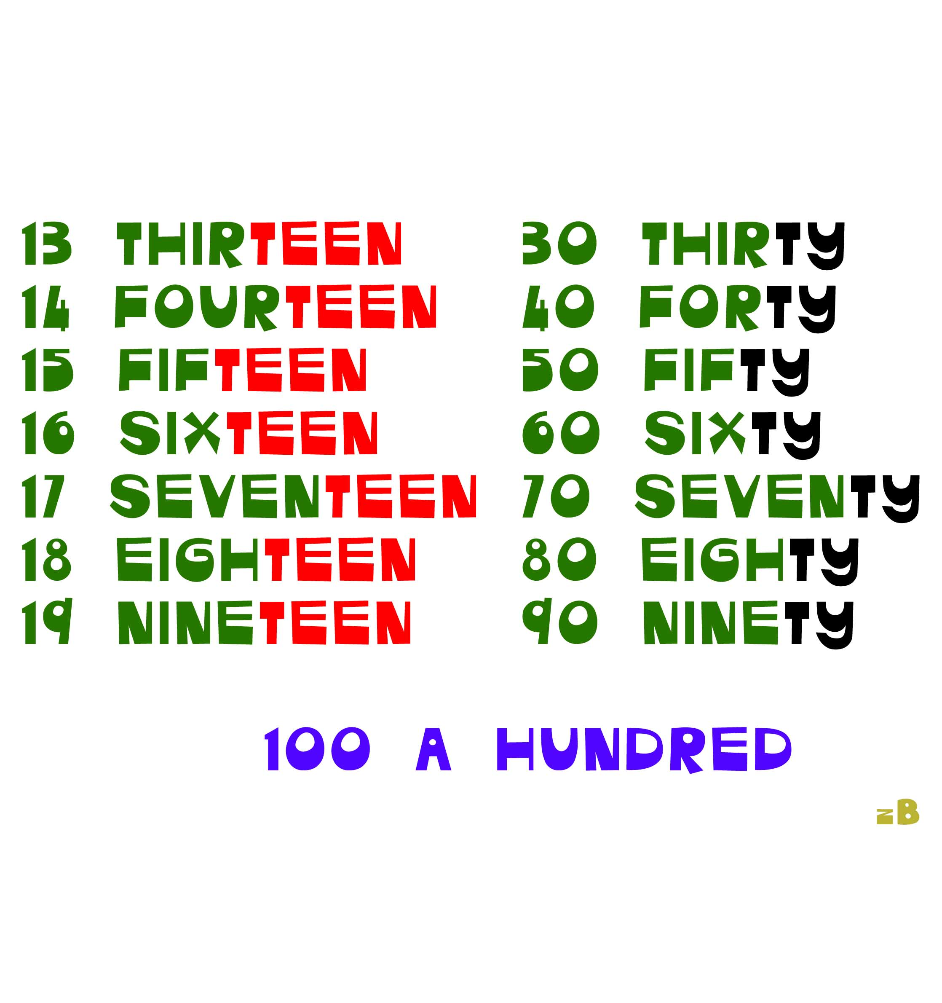

Slide 6
A. SIXTEEN B. SEVENTEEN C. SIXTY

Slide 7
A. FOURTY-THREE B. FOURTEEN C. FORTY-THREE

Slide 8
A. FIFTEEN B. FIFTY C. SIXTY

Slide 9
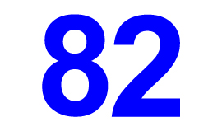
A. EIGHTEEN B. EIGHTY-THREE C. EIGHTY-TWO

Slide 10
A. FIFTY B. FIFTEEN C. TWELVE

