Slide 1
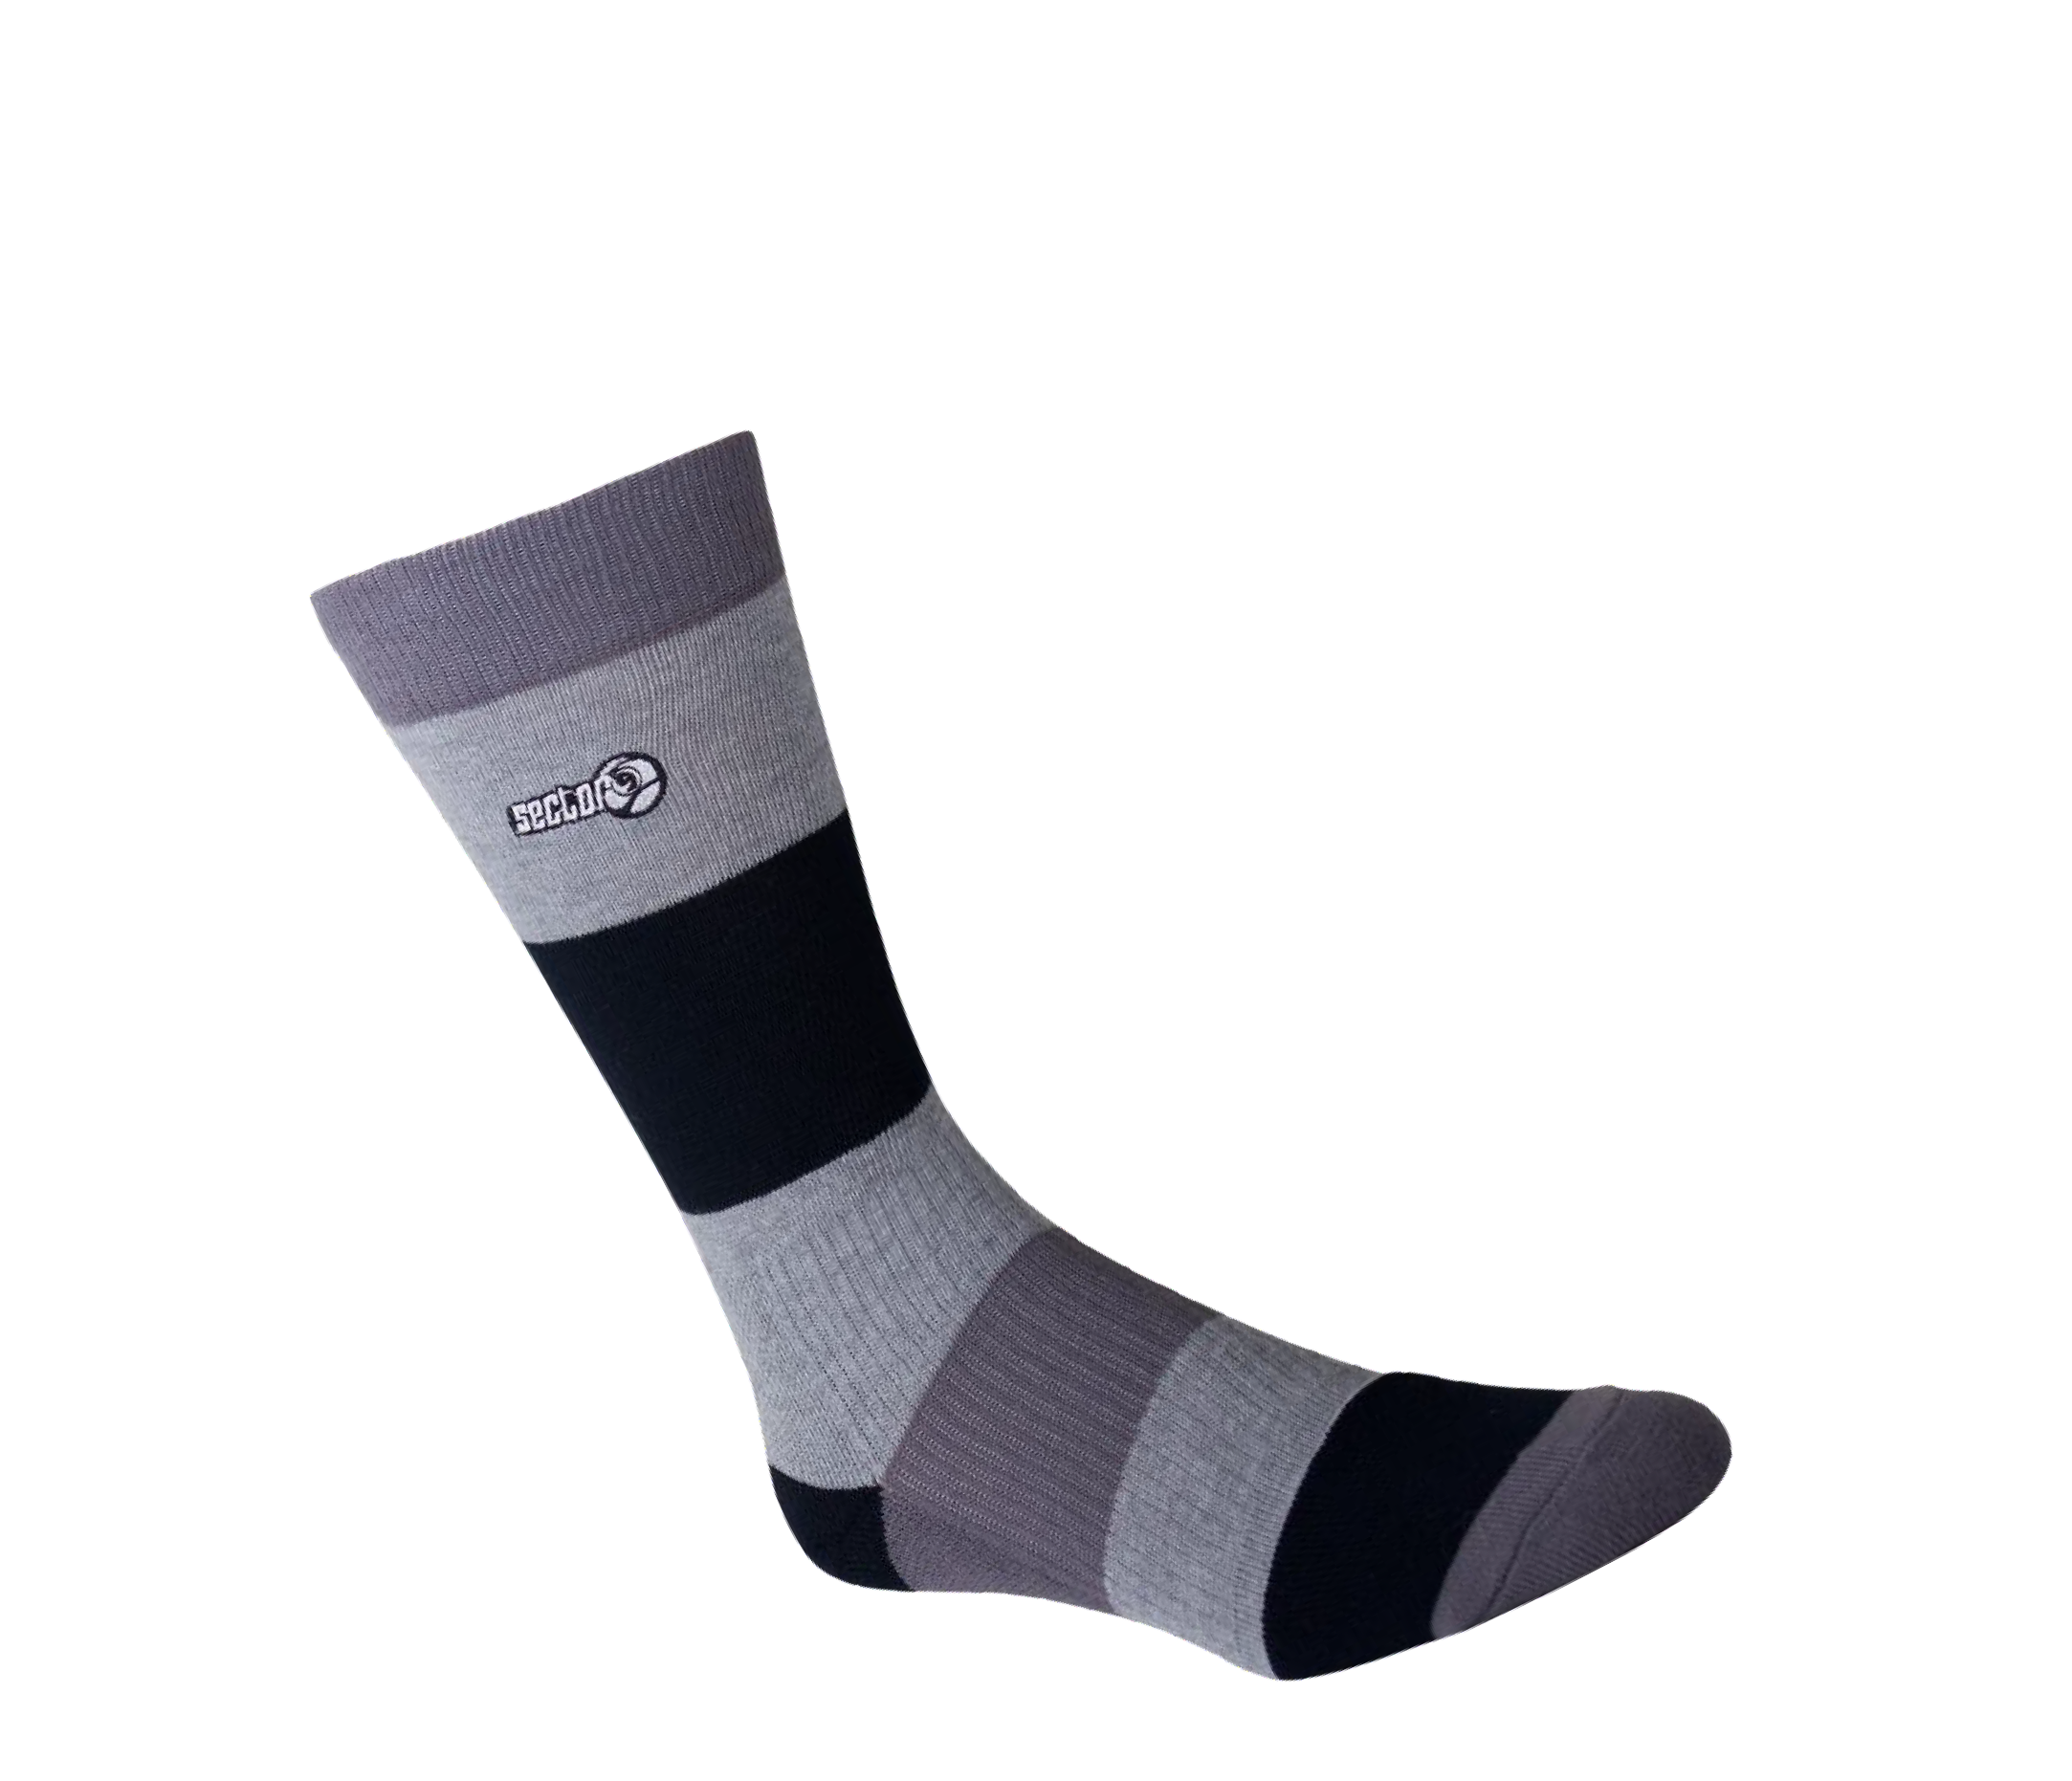
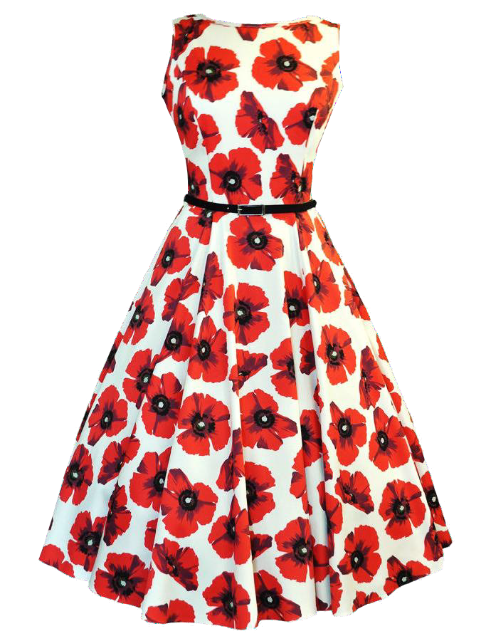
UNİT
8
MY CLOTHES

Slide 2
WORD LIST
WORD LIST
rainy sunny windy snowy cloudly
:yağmurlu
:güneşli
:rüzgarlı
:karlı
:bulutlu
rainy sunny windy snowy cloudly
:yağmurlu
:güneşli
:rüzgarlı
:karlı
:bulutlu
summer :yaz
summer :yaz
winter
:kış
winter
:kış
autumn :sonbahar
autumn :sonbahar
spring
:ilkbahar
spring
:ilkbahar

Slide 3
WORD LIST
WORD LIST
put on/wear:yağmurlu borrow :ödünç almak need :ihtiyaç duymak cold :soğuk
hot :sıcak
warm :ılık
boots coat dress jacket jeans
:bot-çizme
:palto-mont
:elbise
:ceket
:kot pantolon
raincoat :yapmurluk
cool nice
:serin
:güzel
shirt
:gömlek
T-shirt :tişört
gloves :eldiven
umbrella :şemsiye

Slide 4
WORD LIST
WORD LIST
hat short
:şapka
:şort
dirty broken
:kirli
scarf :atkı
shoes :ayakkapı
:kırılmış
skirt
:etek
socks :çorap
sunglasses :güneş gözlüğü
trousers :pantolon

Slide 5
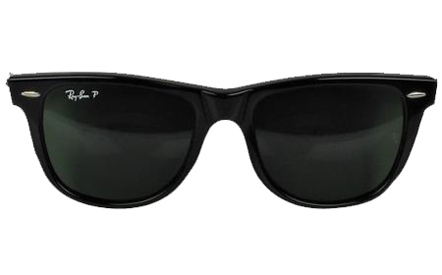
What’s the weather like? (Hava nasıl?)
What’s the weather like?
It is snowy.
(hava karlı)
It is sunny. Put on sunglasses.
Put on your boots.
(botlarını giy)
Monday
Saturday
Wear your gloves.
(eldivenlerini giy)
What’s the weather like on Saturday?
It is rainy. Take your umbrella.
It’s hot.
(Hava yağmurlu. Şemsiyeni al.)
What’s the weather like on Monday?
It’s cloudly.

Slide 6
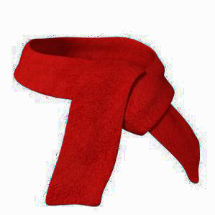
May I borrow your skirt?
May I borrow your umbrella?
Eteğini ödünç alabilir miyim?
Yes here you are.
No, sorry. It’s broken.
Yes here you are.
Of course.
Evet, buyurun.
Tabi ki.
No, sorry. I need it.
Olumsuz cevaplarda
May I borrow your scarf ?
No, sorry. It’s dirty.
No, sorry. I need it.
Yes here you are.
No, sorry. It’s dirty.
Hayır, üzgünüm. Ona ihtiyacım var.
No, sorry. I need it.
Hayır, üzgünüm. O kirli.

Slide 7
winter
spring
summer
autumn

