Slide 1
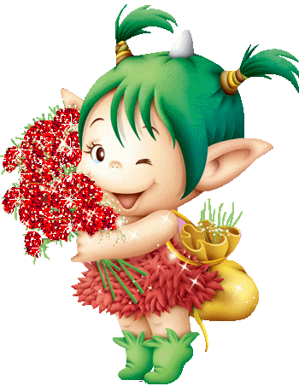
FREE TIME ACTIVITIES

Slide 2
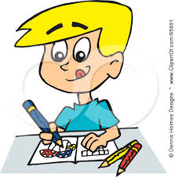
COLORING

Slide 3
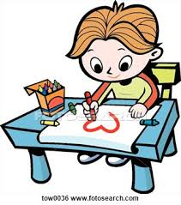
DRAWING

Slide 4
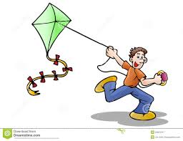
FLYING A KITE

Slide 5
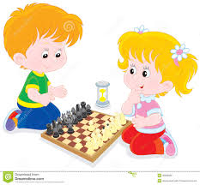
PLAYING CHESS

Slide 6
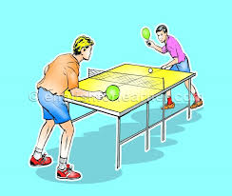
PLAYING TABLE TENNIS

Slide 7
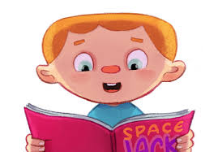
READING A BOOK

Slide 8
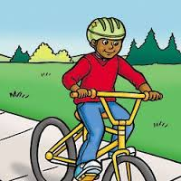
RIDING A BIKE

Slide 9
SINGING

Slide 10
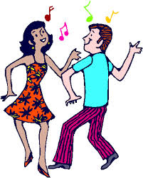
DANCING

Slide 11
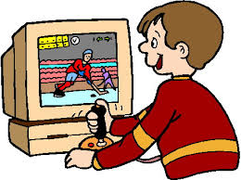
PLAYING COMPUTER GAMES

Slide 12
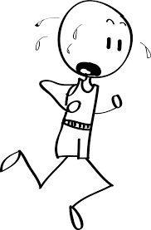
RUNNING

Slide 13
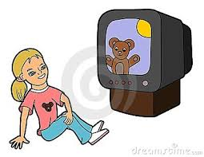
WATCHING CARTOONS

Slide 14
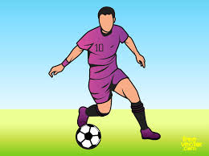
PLAYING FOOTBALL

Slide 15
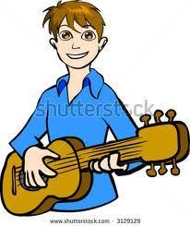
PLAYING THE GUITAR

Slide 16
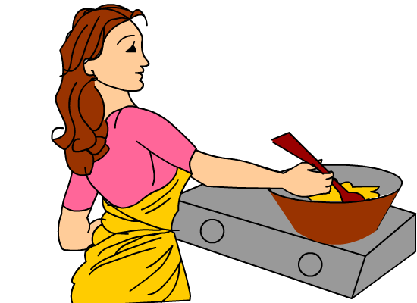
COOKING

Slide 17
LISTENING TO MUSIC

Slide 18
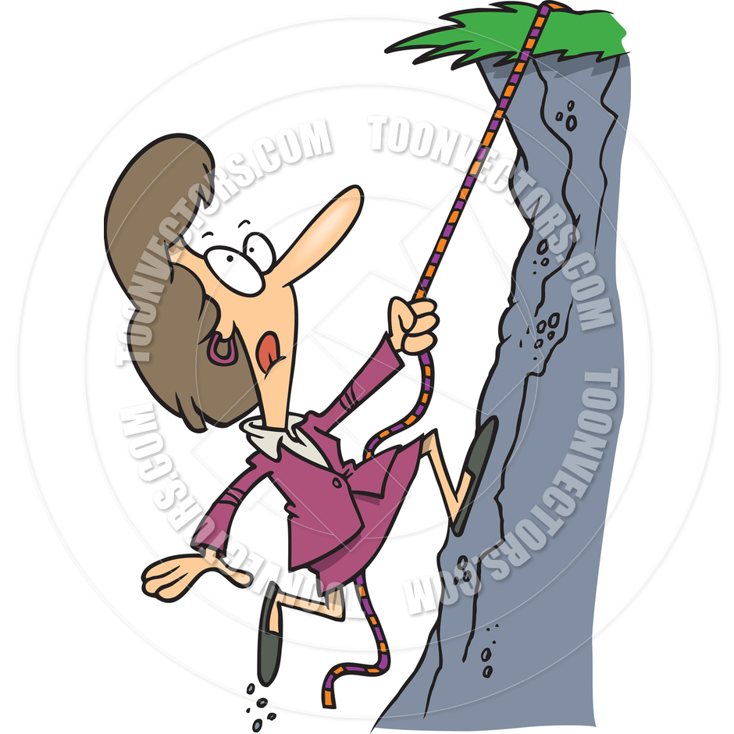
CLIMBING

Slide 19
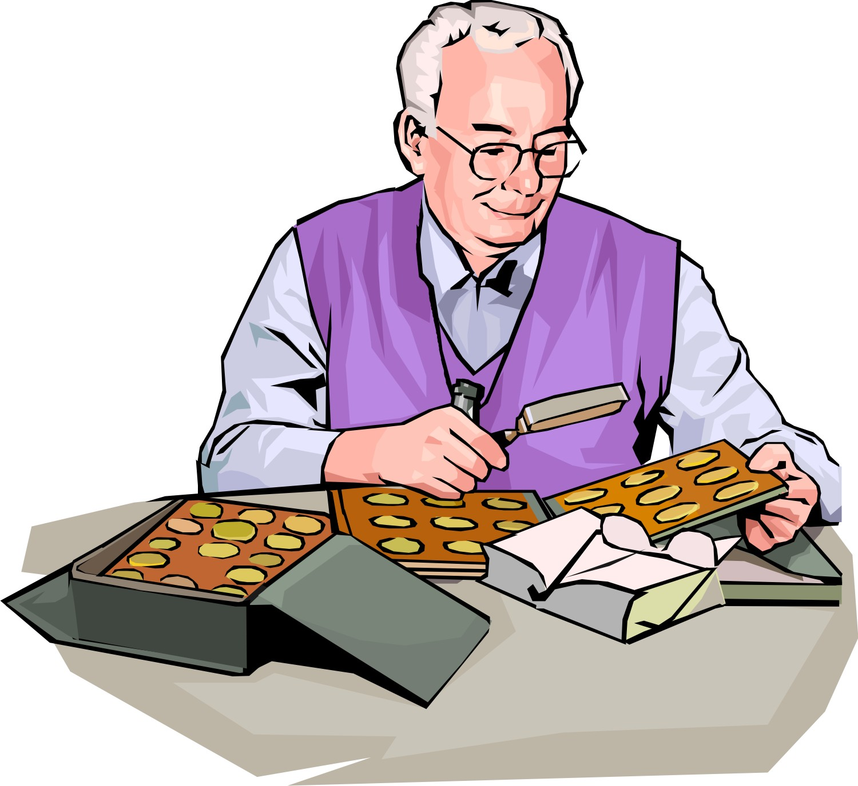
COLLECTING COINS

Slide 20
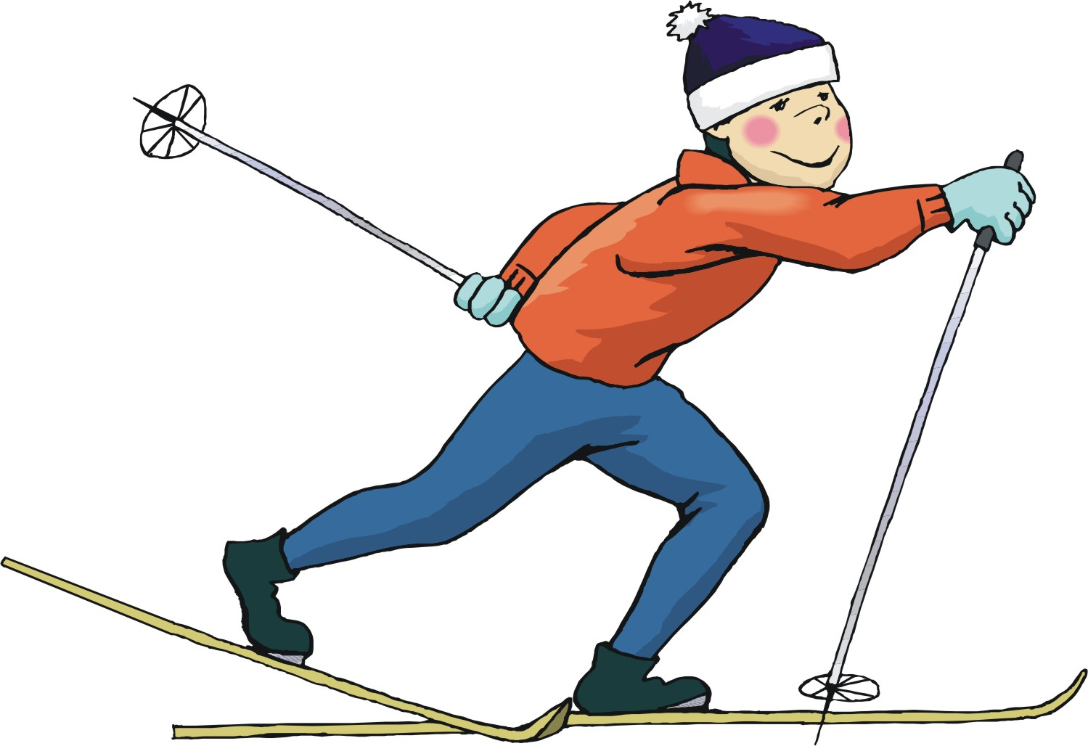
SKIING

Slide 21
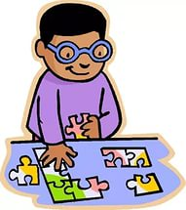
DOING PUZZLES

Slide 22
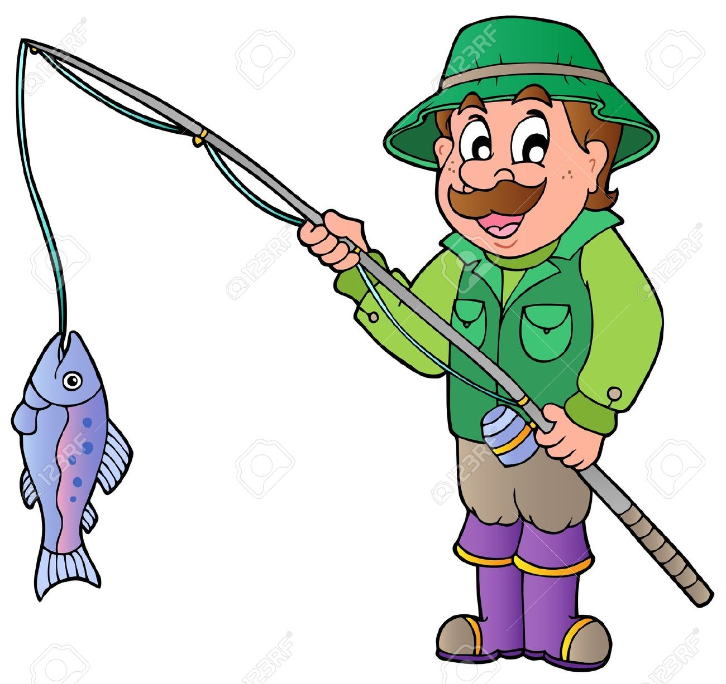
FISHING

Slide 23
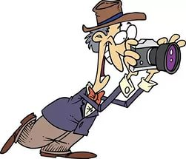
TAKING PHOTOGRAPHS

Slide 24
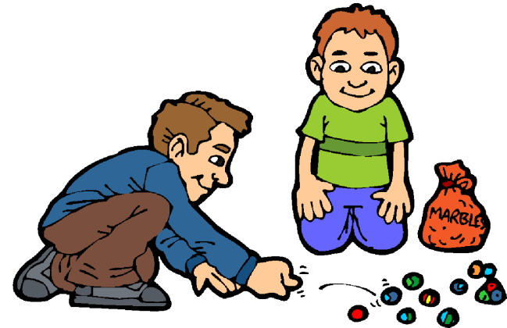
PLAYING WITH MARBLES

Slide 25
DIVING

Slide 26
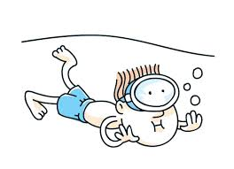
SWIMMING

