Slide 1
İngilizce Saatler

Slide 2
Clock

Slide 3
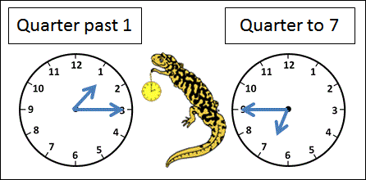
Quarter Past
ÇEYREK GEÇİYOR
09:15=It’s quarter past nine.=9’u çeyrek geçiyor.
10:15=It’s fifteen past ten

Slide 4
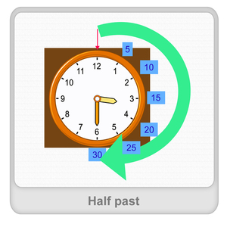
Half Past
15:30=It’s half past three
16:30=It’s thirty past four

Slide 5
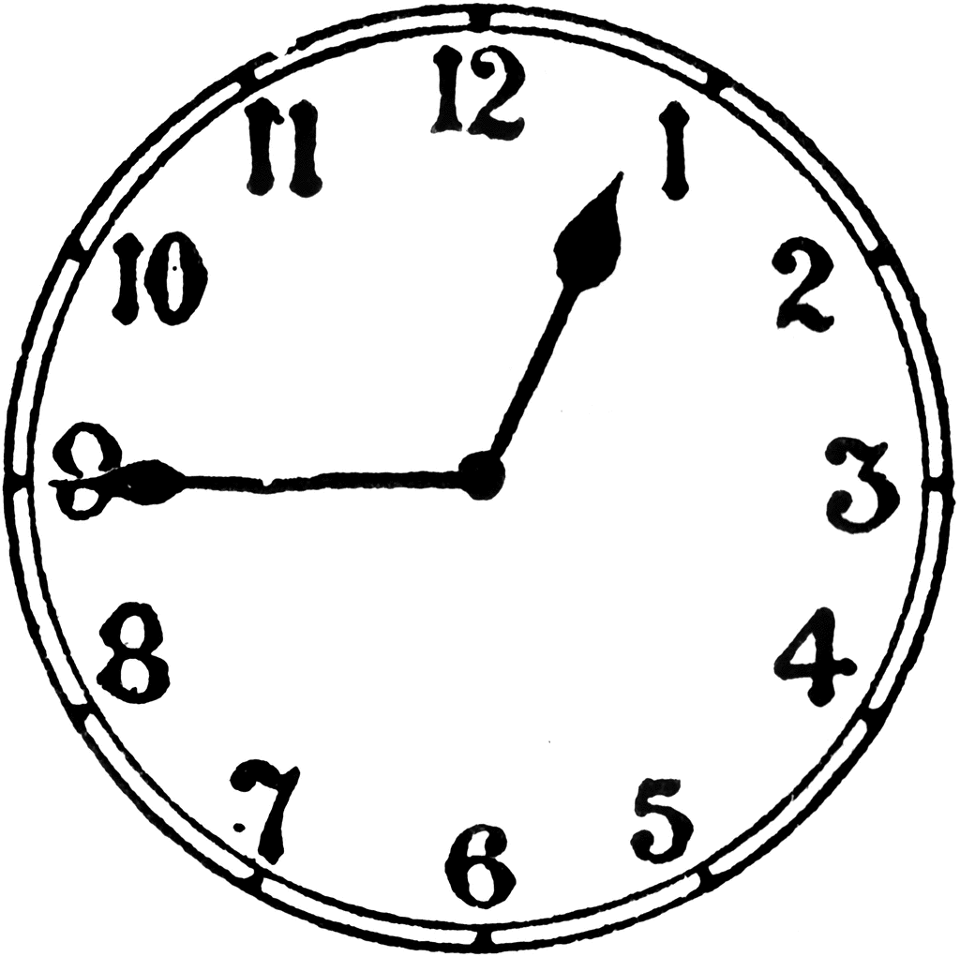
Quarter To
15:45=It’s quarter to three

Slide 6
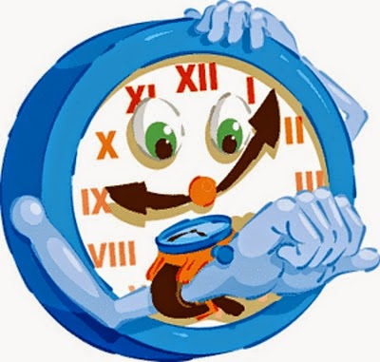
PAST
21:18= It’s eighteen past nine.

