Slide 1
MESLEKLER

Slide 2
VET

Slide 3
GARDENER

Slide 4
MECHANİC

Slide 5
NURSE

Slide 6
POSTMAN

Slide 7
FARMER

Slide 8
CLOWN

Slide 9
SİNGER

Slide 10
COOK

Slide 11
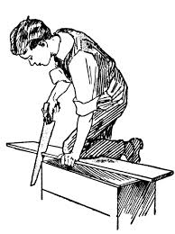
CARPENTER

Slide 12
ENGİNEER

